Slide 1
Justification for ERP
Information Technology

Slide 2
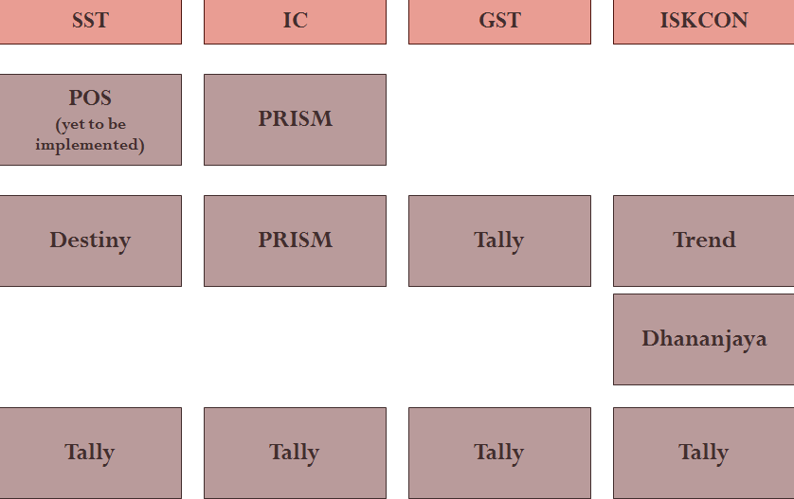
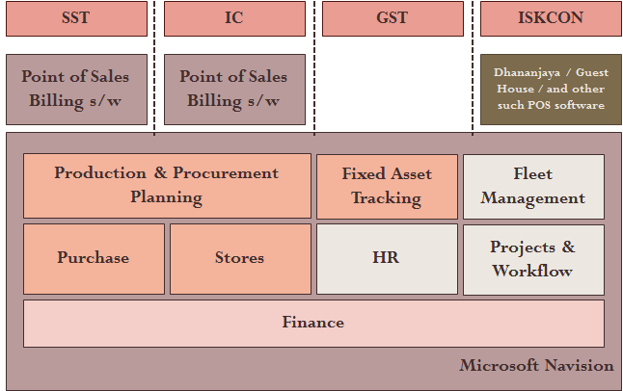
What is ERP?
ERP stands for Enterprise Resource Planning.
ERP is a business management software that allows an organization to use a system of integrated applications to manage the business.

Slide 3
Why ERP?
Integrates all departments and functions of a organization onto a single computer system. Provides one version of the truth.
Optimizes resource utilization (man, material, machinery)
Standardizes the operations & processes, thus eliminating waste.
Reduces effort and knowledge drain.
Improves efficient man power utilization by removing redundant effort.
Decisions need not be faith based (subjective), but can be made based on data.

Slide 4
Do WE need ERP?
Yes. As per 2013-2014 data the size of our operations is 70 crores.
An operation of this size requires extensive control that an ERP provides.
With our new projects and initiatives this will only grow.
Professional systems and processes need to be implemented and adhered to, so that we can control our financial and reputational losses.
Categories | ISKCON Blr | IC (Foods) | SST (YMG) | GST | Total
Sales |  | 15.25 | 16.71 | 4.20 | 36.16
Purchases | 6.08 | 6.12 | 11.38 | 2.60 | 26.18
Giveaways | 1.41 |  |  |  | 1.41
Inventory | 0.50 | 0.75 | 1.30 | 0.45 | 3.00
Fees & Tickets | 2.12 |  |  |  | 2.12
Donation | 16.95 |  |  |  | 16.95

Slide 5
What if we don’t go for ERP?
ERP provides a backbone for our organization to function efficiently.
Disconnect between the departments will continue to exist.
The version of truths reported by different departments will not match. For example, donations reported by finance and DCC will never be the same.
Lot of effort will be spent in entering, re-entering, reconciling, collating, reporting data.
Risk of people getting used to bad practices which will create more burden for change management when we make the decision after a year or two
We will be spending on customization of existing disconnected systems like Destiny for YMG, PRISM for THT and so on.
Decisions will be driven by subjective aspects / faith based than being based upon objective reports.
Resource utilization will not be optimal.
Devotees are getting more and more involved into operational issues & they becoming free for preaching will be risk prone.

Slide 6
A Case for ERP - YMG
The dependency on Destiny software will continue if we do not implement the ERP system.
Destiny was a time gap arrangement made to replace the earlier system (Trend) which was falling apart.
Destiny does not integrate with the finance systems and the details of purchase, stores, sales and settlements has to be reentered into Tally.
Moreover, the vendor is a small time player and is not able to cope with our growing business.

Slide 7
A Case for ERP – IC (Foods)
PRISM used by IC is originally a Restaurant Billing Software.
It is a very good software used across industry for billing purposes only.
Suitable for customer billing at Annakuta and Higher Taste Restaurants.
Due to lack of ERP, PRISM is extended beyond its capability to handle purchase, stores, manufacturing, Bill of Materials etc., with heavy customizations.
Software is developed on a platform which is outdated.
It cannot support expansion of the business outside our premises and the licenses are location-based (similar to Tally).
It does not integrate with the Finance system (Tally) and hence Sales, Purchase, manufacturing data need to reentered by Finance team in Tally.

Slide 8
A Case for ERP – Finance Integration
Finance has to reenter the following data into the Tally system irrespective of the data being entered in each of the end points.
Donations – Re-entry of data entered in Dhananjaya software used by DCC
Purchase, Sales, Manufacturing data of Food Business
Purchase, Stores, Sales and Settlement data of YMG – Paraphernalia business
Purchase, Sales and Manufacturing data of Goloka Agarbatti Business.
Purchase data of ISKCON – Re-entry of data entered in Trend software.
Guest House Collection data: Re-entry of data entered in GH software.
Salary & Wages: Re-entry of data already entered in HR Paygenie software.
Krishnamrita: Re-entry of data entered in Tally used by Krishnamrita.
Not only the entry is repeated, but also reconciliation should happen on a periodical basis with each of these systems to ensure that there is no mismatch of data & the version of the truth is identical.

Slide 9
A Case for ERP – Financial Accounting
Tally is meant for small businesses and we have out grown it long back.
Tally is heavily customized and loaded. (spent around 5L)
In spite of customizations, Tally could not generate all the required reports due to the inherent limitations.
Wrong accounting classifications are not revealed in time.
Budgeting exercise is not as efficient as it should be since the departments are not having visibility to the finance data concerning their department.
The MIS reports get delayed due to re-entry and reconciliation issues.
Devotees become more involved into sorting out the transactional issues than merely focusing on strategy.

Slide 10
A Case for ERP – Material Management
Material management in ISKCON, Krishnamrita and the businesses.
Unplanned Purchases
Documentation are not sufficient.
In many cases, the documentation is done after transaction just for the finance to clear the bill (ratification).
Similar situations in Krishnamrita also.
Transactions in ISKCON Stores | Main Store | Sub Store | Grand Total | %age
Invoice is after PO | 296 | 1,459 | 1,755 | 27%
No PO raised - Cash Pur | 114 | 989 | 1,103 | 17%
PO & Invoice on same day | 484 | 1,392 | 1,876 | 29%
PO raised after Invoice | 147 | 1,509 | 1,656 | 26%
Grand Total | 1,041 | 5,349 | 6,390 | 100%

Slide 11
A Case for ERP - Projects
Currently material and man-power segregation are not recorded project-wise and the resource planning is not done efficiently.
Implementing an ERP can add great value in the resource planning for the Vaikuntha Hill Project & any other construction projects.
The ERP solution can provide us complete project management features with Material Management, Land Bank Management, Site Maintenance, Project Planning, Procurement Planning, Job order and sub contract management, resource planning, fixed asset management, property lease management.
The advantage is that the features can also be integrated into hand-helds.

Slide 12
A Case for ERP – Other Possibilities
Implementing ERP system will enable us in automating the following:
Ticket Sales & Fees – 2.12 crore turnover in ISKCON
Voucher / Expense Reimbursements –
Future implementation of hand-held based vehicle parking / footwear
Unified system for tracking customer activity (suppose a person donates to ISKCON, purchases from YMG counters & takes prasadam in restaurants, stays in Guest House, attends our classes and becomes part of FOLK / Krishnashraya – everything can be tracked)
Efficient tracking of Assets and Asset Utilization
In HR currently only Payroll is automated and many other processes are manual. Human Resource Management System is part of the ERP and available with self service modules for employees.

Slide 13
Current Scenario
SST
IC
GST
ISKCON
POS
(yet to be implemented)
PRISM
Destiny
PRISM
Tally
Trend
Dhananjaya
Tally
Tally
Tally
Tally

Slide 14
Proposed Scenario
SST
IC
GST
ISKCON
Point of Sales
Billing s/w
Point of Sales
Billing s/w
Dhananjaya / Guest House / and other such POS software
Microsoft Navision
Production & Procurement Planning
Fixed Asset Tracking
Fleet Management
Purchase
Stores
HR
Projects & Workflow
Finance

Slide 15
Why are we going with Microsoft?
Microsoft has many donation programs for NGOs and charitable organizations.
Recently we have submitted the documents establishing our status as a charitable society and got approval as an organization eligible for donations under the charitable programs of Microsoft.
Office 365 – our mail boxes in cloud are now free of cost. Microsoft has given us 1000 mailboxes under the plan of $8 per mail box per month. i.e. the worth is $8000 per month.
Microsoft has also donated us the operating system (Windows 7) licenses and MS-Office 2010 licenses free of cost. Thanks to this donation we are using licensed version of the OS and Office across the organization.
Microsoft has also agreed for a 75% discount on the ERP licenses provided we sign an agreement with them before Mar 14, 2014. At 75% discount, the license cost is around 55 lakhs (exclusive of tax)

Slide 16
Why MS-Dynamics NAV?
The Akshaya Patra Foundation has opted for MS-Dynamics AX.
For ISKCON, we are recommending MS-Dynamics NAV.
MS NAV is meant for SME segment & there are not many other players.
MS NAV license costs lesser than MS AX and the other players like SAP.
Microsoft is agreeing to reduce the license cost by 75%
It is a good alternative for SME struggling with Tally.

Slide 17
What is expected from management?
Budget approval
Allocate required resources for implementation
Support for Change in the Organization
Commitment to implement processes & standard procedures
Not change the team responsible for implementation till the end of project
Willingness to adopt best practices than trying to customize the ERP to fit our specific processes evolved independently over a period of time.
Help implementation team in handling the following challenges
People resistance to change
Resistance to share information across departments

Slide 19
Option 1
If we are not for full fledged implementation, which is most recommended, at least we should implement in YMG, as without this, business growth may just be a dream
This may cost us around 27L
Replace tally with another interim application like Busy software (which is a reasonable alternative for finance only application)

Slide 20
Option 2
If we are not for full fledged implementation, which is most recommended, at least we should implement in YMG, as without this, business growth may just be a dream
This may cost us around 27L
Also implement MS Navision in ISKCON accounts only
This may cost us another 30L

